Slide 1

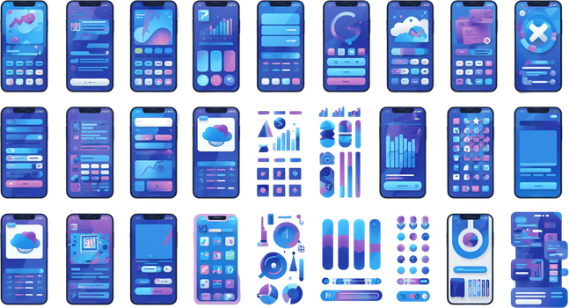
UI ELEMENTS & UX DESIGN
Presented by BALAJI

Slide 2

OBJECTIVES
Understanding UI Elements: UI (User Interface) elements are the visual components users interact with in apps like Instagram, CapCut, Notes, and Gallery. These include buttons, icons, menus, sliders, text fields, and navigation bars.
Understanding UX: UX (User Experience) refers to the overall journey a user takes while interacting with an app. It encompasses usability, accessibility, visual design, and how intuitively users can achieve their goals in apps like Adobe, Instagram, and CapCut.
2

Slide 3
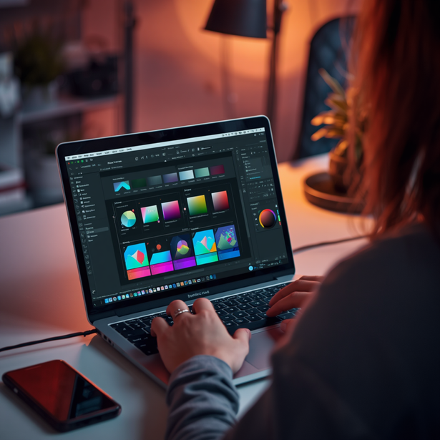
ADOBE APPS
UI Elements: Adobe apps feature tool panels, layers panel, properties panel, and customizable workspaces. Toolbars are context-sensitive, adapting to the active task. Icons use consistent visual language across the Creative Cloud suite for familiarity.
UX Design: Adobe prioritizes professional workflow with non-destructive editing, smart guides, and keyboard shortcuts. The learning curve is steep but rewarding, offering deep creative freedom. Workspace customization allows users to tailor layouts to their specific creative process.
3

Slide 4
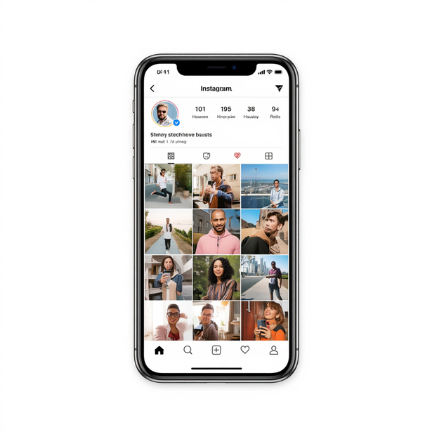
INSTAGRAM
UI Elements: Stories bar at the top, Reels tab, bottom navigation bar, heart/like icons, comment bubbles, and share buttons create a visually consistent and recognizable interface across the app.
UX Highlights: Endless scroll keeps users engaged, instant sharing via Stories and Reels enables quick content creation, and social engagement features like likes and comments drive strong user interaction.
4

Slide 5
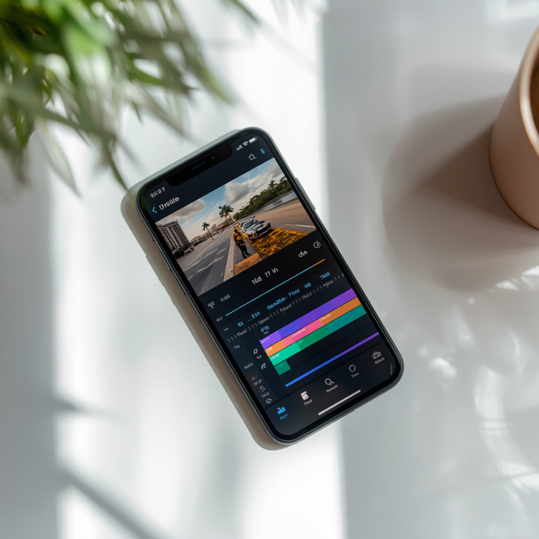
CAPCUT
UI Elements: Timeline editor for frame-by-frame control, effects & filters library, sticker/text overlays, audio mixer panel, and a prominent Export button for quick sharing.
UX Highlights: Intuitive drag-and-drop video editing, template-based creation for fast results, smooth transitions, auto-captions, and one-tap export optimized for social media platforms.
5

Slide 6
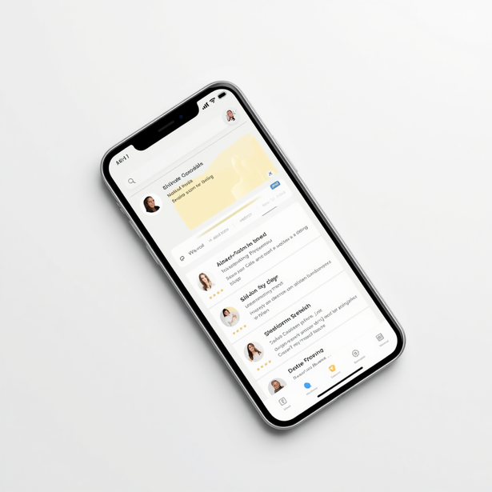
NOTES APP
UI Elements: Folder sidebar for organization, search bar with instant filtering, formatting toolbar (bold, italic, checklists), and pinned notes section for quick access.
UX Highlights: Minimalist design reduces cognitive load, quick capture allows instant note creation, seamless iCloud/Google sync across devices ensures content is always accessible.
6

Slide 7
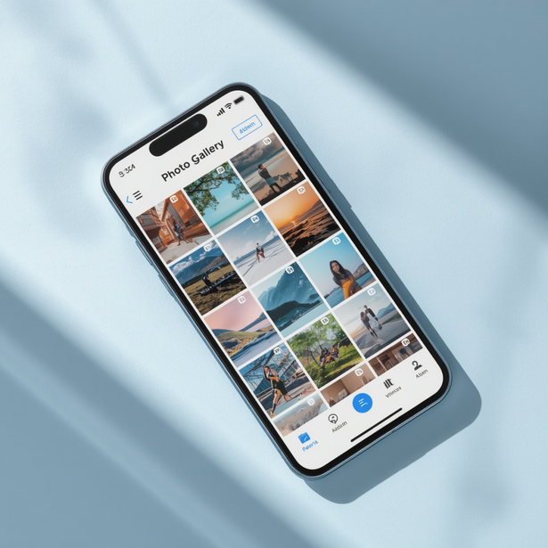
GALLERY APP
UI Elements: Grid view layout for media display, album folders for organization, date/location headers for grouping, share button, selection toolbar, search icon, and overflow menu for additional options.
UX Highlights: Visual-first organization makes browsing intuitive. Chronological grouping and smart albums enable quick media access. Pinch-to-zoom gestures and smooth scrolling enhance the viewing experience.
7

Slide 8
KEY TAKEAWAYS
Consistency in UI elements builds familiarity. When apps like Instagram, Adobe, and CapCut use recognizable icons, layouts, and interactions, users feel confident navigating without a learning curve.
1.
Good UX prioritizes user goals and reduces friction. Whether in Notes, Gallery, or Adobe apps, intuitive flows and minimal steps keep users focused on their task rather than the interface.
2.
Each app tailors its design to its core purpose. CapCut optimizes for quick edits, Instagram for visual storytelling, and Adobe for professional precision — form always follows function.
3.
8

Slide 9

THANK YOU!
Questions? Let's discuss UI/UX in your favorite apps!

